Slide 1

Linear Regression Chapter-5
The Conclusion
Dr. Deepak Mehta

Slide 2

Problem Statement
The dataset of two region of Algeria namely the Bejaia region located in the northeast of Algeria and the Sid bel-abbes region located in the northwest of Algeria.
If user can predict the temperature based on different-different features.
Prediction result can be used for forest fire situation Tackers & Make correct prevention to avoid it in future

Slide 3
Data Collection
The dataset is collected from website named, UCI machine learning repository (in given link below).
The dataset consist of 15 columns and 244 rows
https://archive.ics.uci.edu/ml/datasets/Algerian+Forest+Fires+Dataset++

Slide 4
Used Libraries
Pandas
Numpy
Matplotlib.pyplot
Seaborn
Plotly.express

Slide 5
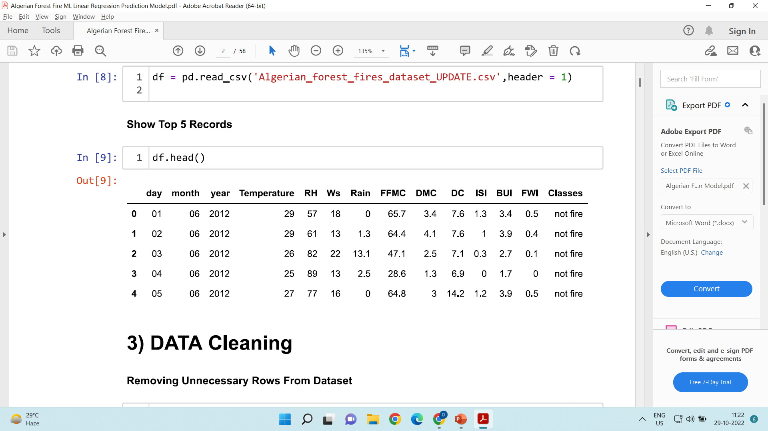

Slide 6
Adding New Features and columns striping
df.loc[:122,’region’]=‘bejaia’
df.loc[122:,’region’]=‘Sidi-Bel Abbes’
df.columns=[i.strip() for i in df.columns]
df.columns
df.Classes=df.Classes.str.strip()
df.Classes.unique()

Slide 7
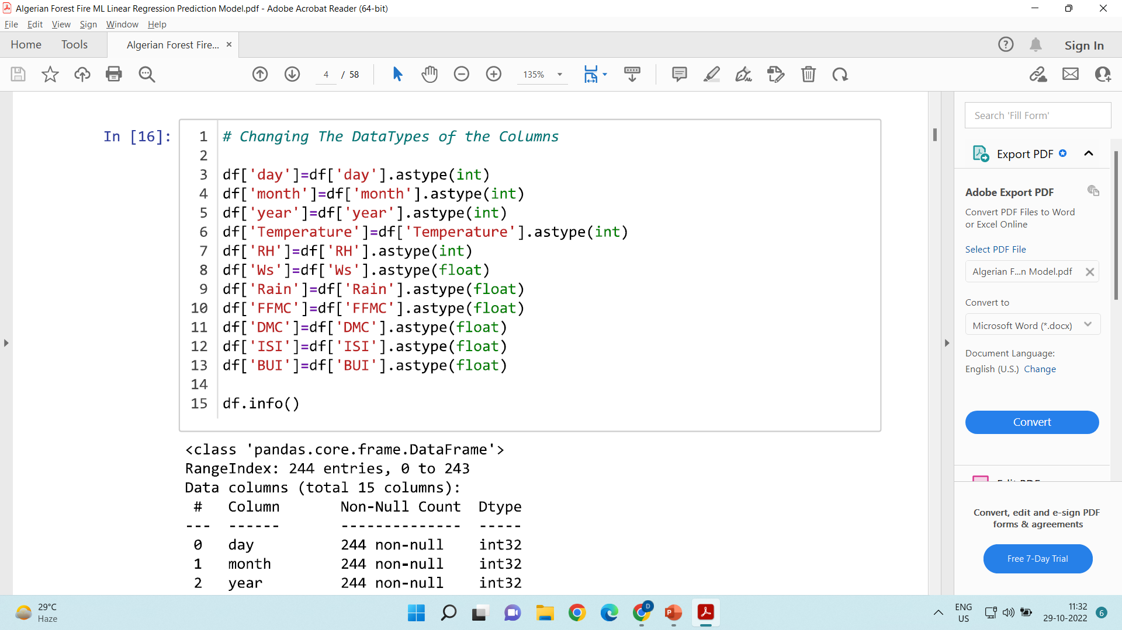
Data Type Changes

Slide 8
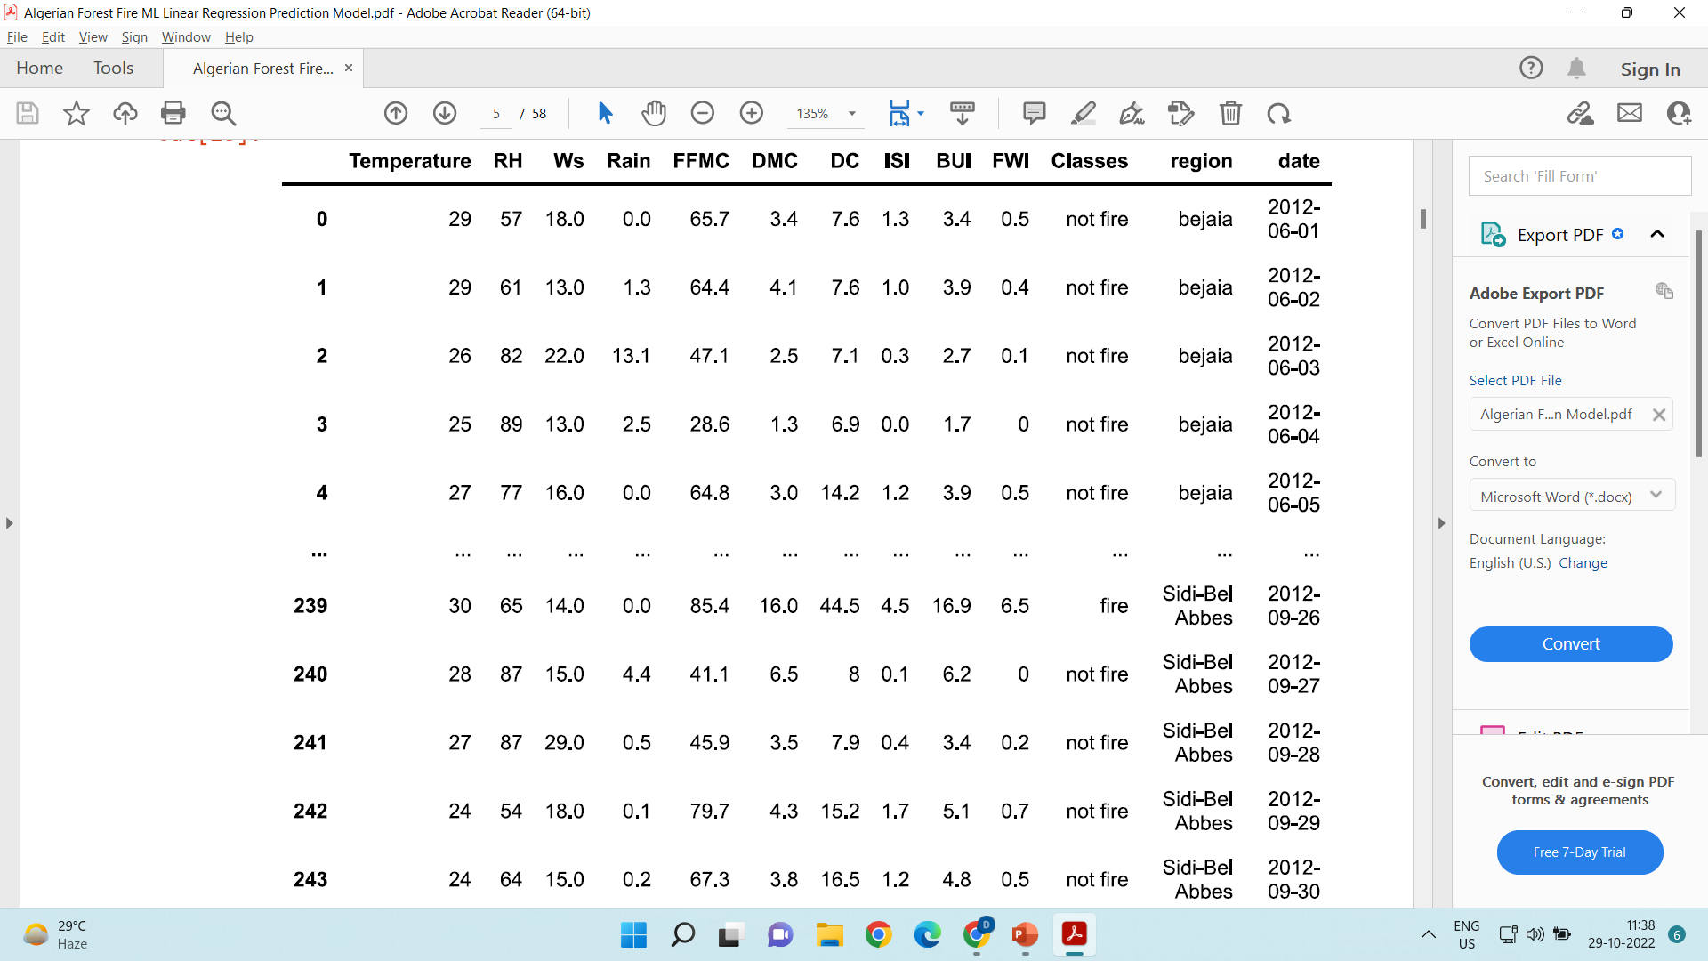
Replacing Unnecessary Features
df[‘date’]=pd.to_datetime(df[[‘day’,’month’,’year’]])
df.drop([‘day’,’month’,’year’],axis=1,inplace=True)

Slide 9
Handling Categorical Features and Replacing Null values
df[‘Classes’]=df[‘Classes’].map({‘not fire’:0,’fire’:1})
df[‘Classes’]=df[‘Classes’].fillna(df[‘Classes’].mode()[0])
df.isnull().sum()

Slide 10
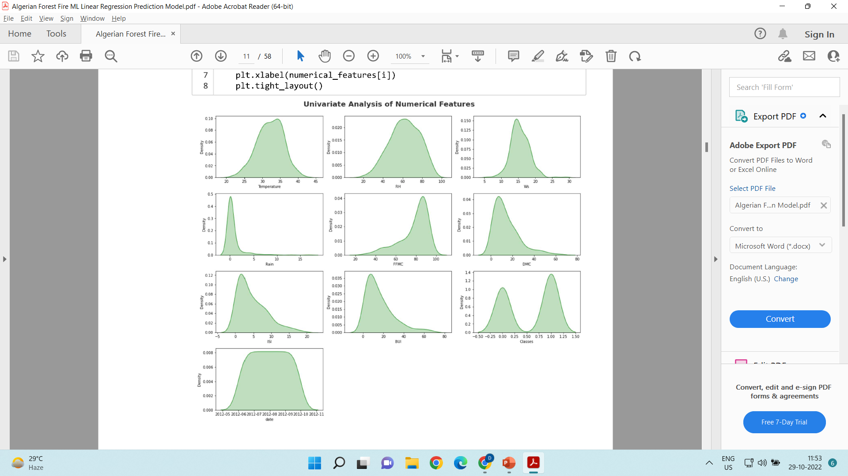
Univariate Analysis
plt.figure(figsize=(15, 15))
plt.suptitle('Univariate Analysis of Numerical Features', fontsize=20, fontweight='bold', alpha=0.8, y=1.)
for i in (0,len(numerical_features)):
plt.subplot(5, 3, i+1)
sns.kdeplot(x=df[numerical_features[i]],shade=True, color='g’)
plt.xlabel(numerical_features[i])
plt.tight_layout()
The term univariate analysis refer to the analysis of one variable prefix “uni” mean one. Its purpose to understand the distribution of values for a single variable

Slide 11
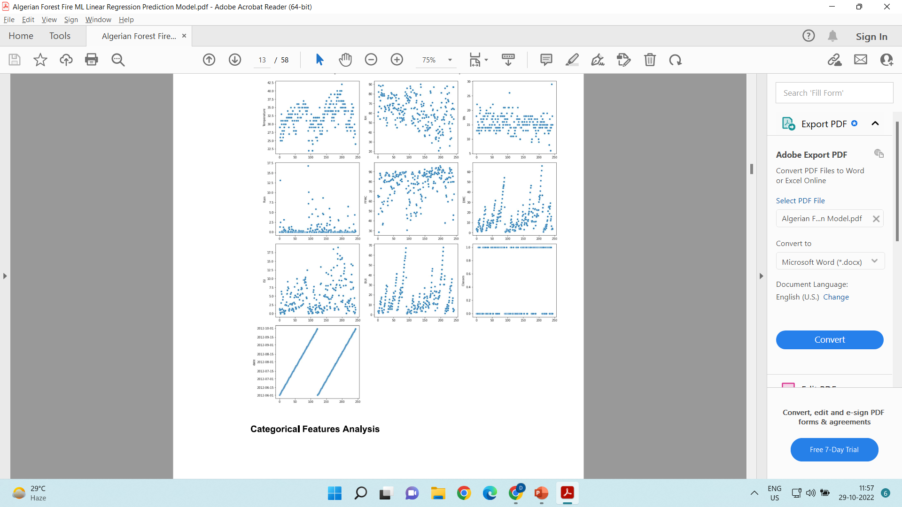
Scatterplot: Numerical Columns
# scatter plot to see the trends in each numerical column
plt.figure(figsize=(15, 20))
plt.suptitle('scatter plot with each numerical feature to explore feature', fontsize=20, fontweight='bold', alpha=1, y=1)
for i in range(0,len(numerical_features)):
plt.subplot(5, 3, i+1)
sns.scatterplot(y=numerical_features[i], x=df.index, data=df)
plt.tight_layout()

Slide 12
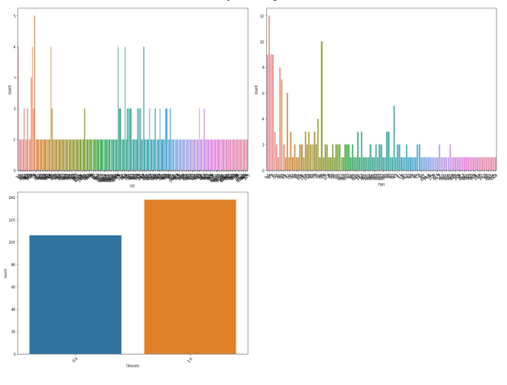
Count plot: categorical Features
# categorical columns Analysis
plt.figure(figsize=(20, 15))
plt.suptitle('Univariate Analysis of Categorical Features', fontsize=20, fontweight='bold', alpha=0.8, y=1.)
cat1 = ['DC', 'FWI', 'Classes’]
for i in range(0, len(cat1)):
plt.subplot(2, 2, i+1)
sns.countplot(x=df[cat1[i]])
plt.xlabel(cat1[i])
plt.xticks(rotation=45)
plt.tight_layout()

Slide 13
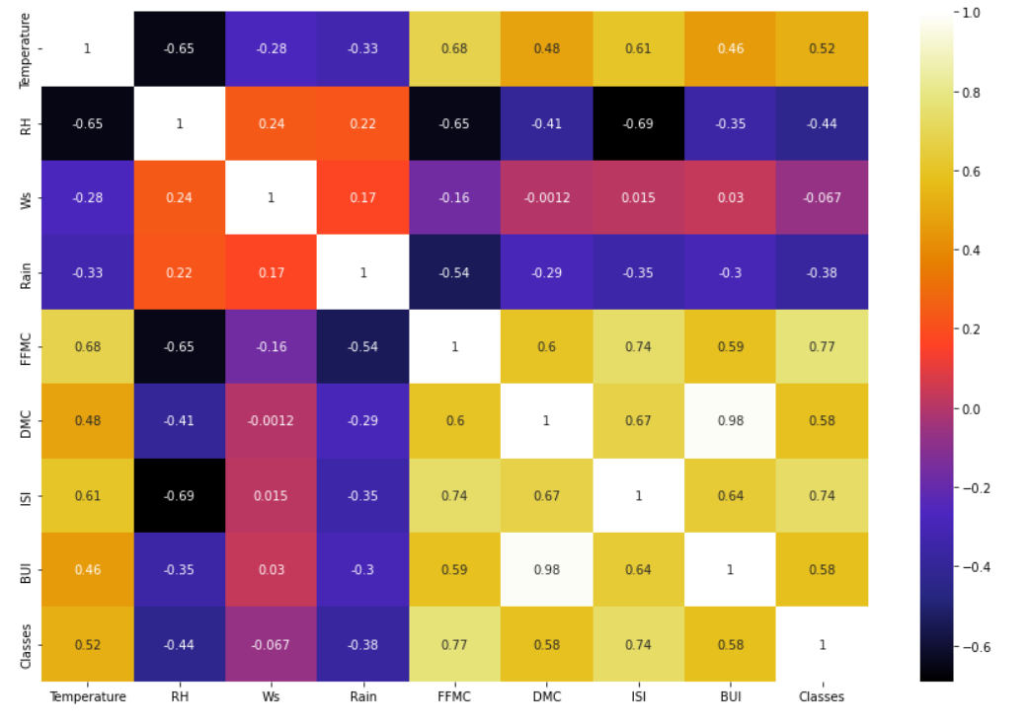
Bi-variate analysis
## Plotting Heatmap
plt.figure(figsize = (15,10))
sns.heatmap(df.corr(), cmap="CMRmap", annot=True)
plt.show()

Slide 14
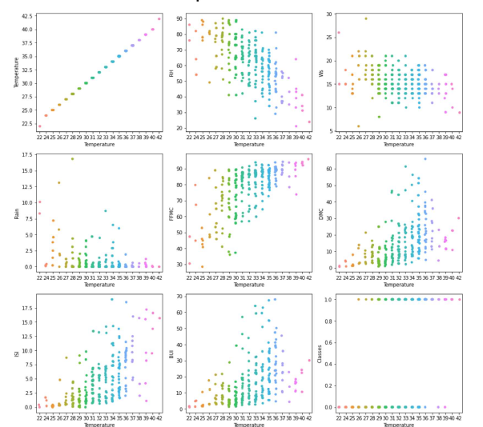
Strip plot: Relationship b/w numerical feature and target feature
plt.figure(figsize=(15, 20))
plt.suptitle('Strip Plot', fontsize=20, fontweight='bold', alpha=1, y=1)
for i in range(0,len(numerical_features)):
plt.subplot(5, 3, i+1)
sns.stripplot(y=numerical_features[i], x='Temperature', data=df)
plt.tight_layout()

Slide 15
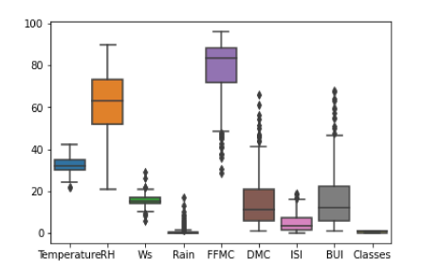
Boxplot: outliers
## Boxplot to find Outliers in the features
sns.boxplot(data = df,orient="v")

Slide 16
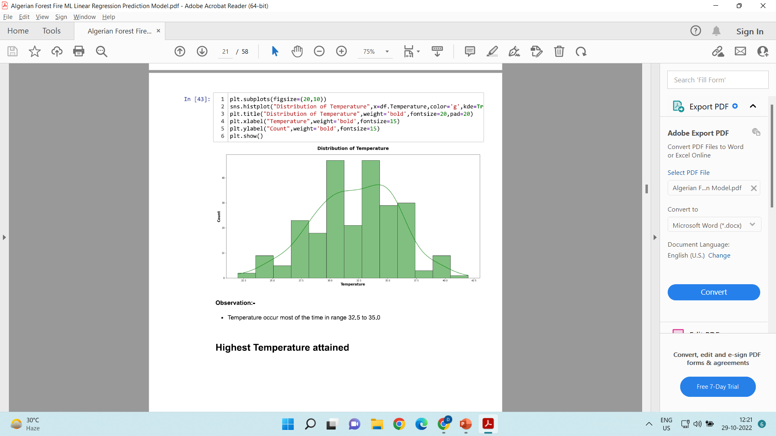
Temperature Range
plt.subplots(figsize=(20,10))
sns.histplot("Distribution of Temperature",x=df.Temperature,color='g',kde=True)
plt.title("Distribution of Temperature",weight='bold',fontsize=20,pad=20)
plt.xlabel("Temperature",weight='bold',fontsize=15)
plt.ylabel("Count",weight='bold',fontsize=15)
plt.show()

Slide 17
Selection: Independent and Dependent Features
x = df.iloc[:, 1:-2] ## x = All Other Numeric Features Except "Temperature" Feature
y = df.iloc[:,0] ## y = Targeted feature "Temperature"
from sklearn.model_selection import train_test_split
X_train,X_test, Y_train, Y_test = train_test_split(x,y, test_size = 0.33, random_state =42)

Slide 18
Feature Scaling
from sklearn.preprocessing import StandardScaler scaler = StandardScaler()
X_train = scaler.fit_transform(X_train)
X_test = scaler.transform(X_test)

Slide 19
Linear Regression
from sklearn.linear_model import LinearRegression
regression = LinearRegression()
regression.fit(X_train, Y_train)
regression.intercept_
regression.coef_
reg_pred=regression.predict(X_test)

Slide 20
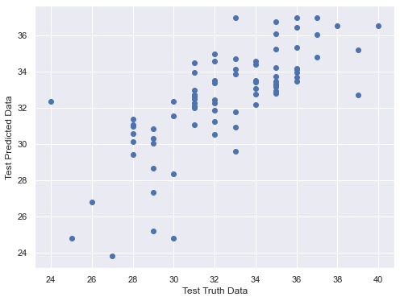
Assumptions: Linear Regression
## Relationship Between Real Data & Predicted Data
plt.scatter(Y_test,reg_pred) ## IF we get Linear Manner , it is good Linear Model.
plt.xlabel("Test Truth Data")
plt.ylabel("Test Predicted Data") ## When we take Test data & Prediction data,then we have an linear distributions

Slide 21
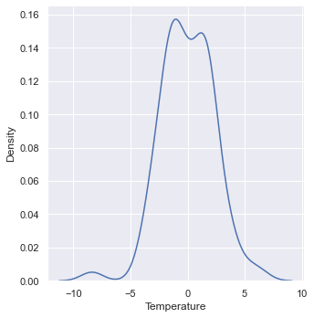
Residual Distribution
Residual=y_test-reg_pred
sns.distplot(Residuals,kind=‘kde’)

Slide 22
Performance Metrics
Mean Squared Error
Mean Absolute Error
Root Mean Squared Error
R^2 (goodness of fitting)
Adjusted R^2

Slide 23
..continued
from sklearn.metrics import mean_squared_error from sklearn.metrics import mean_absolute_error
(mean_squared_error(Y_test, reg_pred))
(mean_absolute_error(Y_test,reg_pred))
(np.sqrt(mean_squared_error(Y_test, reg_pred)))
## R Squared
from sklearn.metrics import r2_score
score=r2_score(Y_test,reg_pred)
print(score)
## Adjusted R square
#display adjusted R-squared
1 - (1-score)*(len(Y_test)-1)/((Y_test)-X_test.shape[1]-1)

Slide 24
Thanks
Deepak.e11296@cumail.in
9812881611

